Slide 1

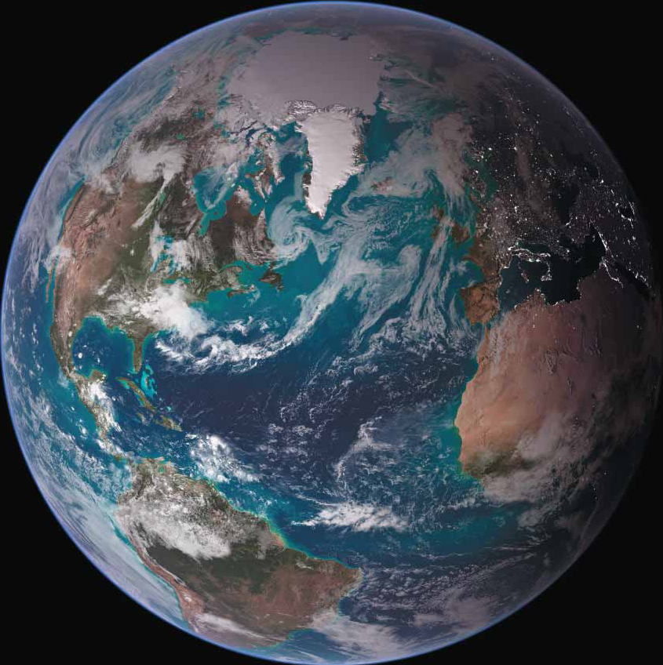

GEOLOGICAL SCIENCES
Explore a Major: Geology
Presented by:
Dr. David Mallinson
Professor and Undergraduate Program Director
Dept. of Geological Sciences
East Carolina University
mallinsond@ecu.edu
The study of the Earth (and other planets), its history, and the interaction of the solid Earth with all other components of the planet
(atmosphere, biosphere, hydrosphere, cryosphere).

Slide 2
GEOLOGICAL SCIENCES
Humanity and Earth are facing critical issues:
  Mineral and Water Resource Needs
  Energy Needs
  Environmental Degradation
  Natural Disasters
  Climate Change
  Sea-Level Rise
  Coastal Erosion
Geoscience careers address these issues, and many others.
The need for well-trained Earth Scientists has never been more urgent.

Slide 3
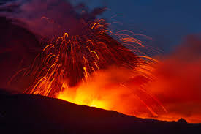
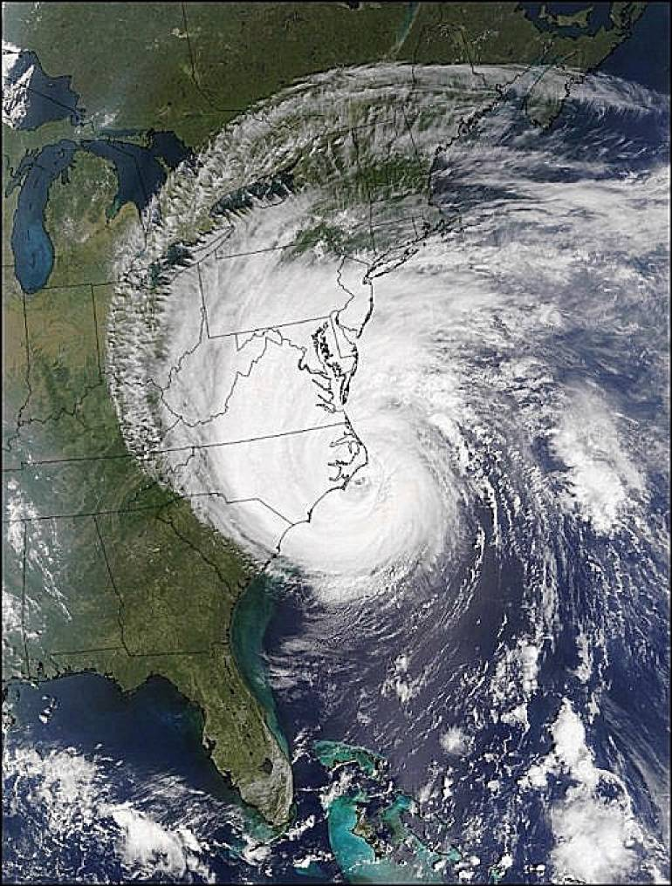
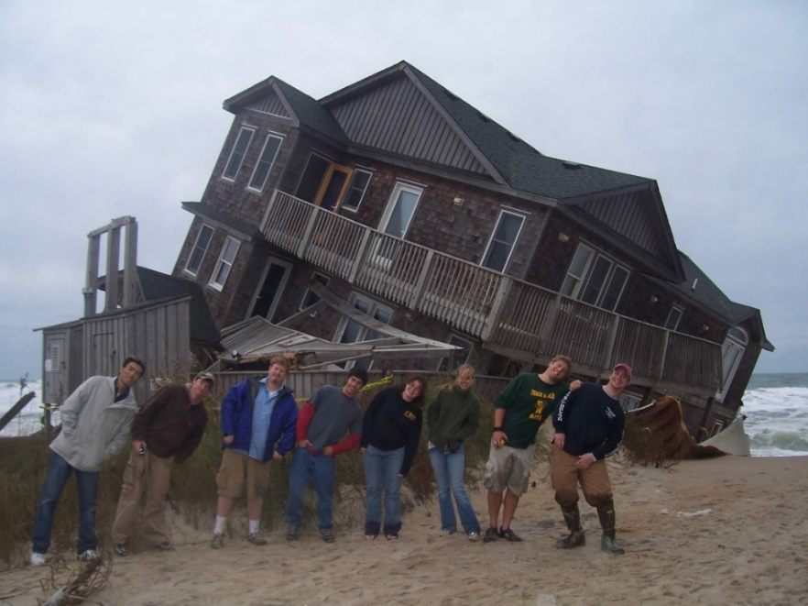
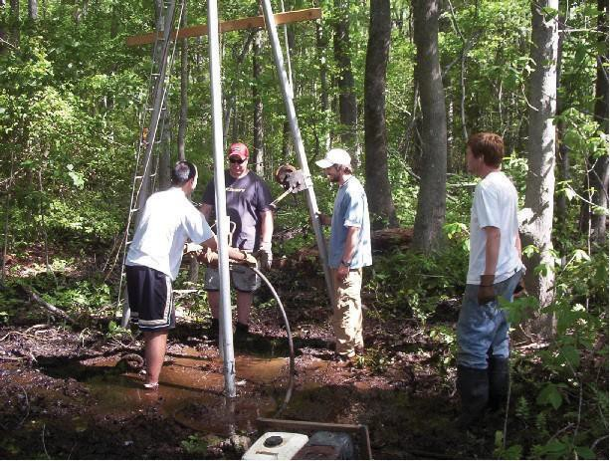
GEOLOGICAL SCIENCES
Geoscientists inform us on:
Where to find natural resources (e.g., water, oil, minerals, sand, etc.)
How to predict geo-hazards (e.g., earthquakes, landslides, volcanic eruptions, tsunami, floods, coastal erosion)
Where to find suitable construction sites
How Earth processes influence biodiversity
How to protect and preserve our natural environment
How and why climate and sea level change

Slide 4
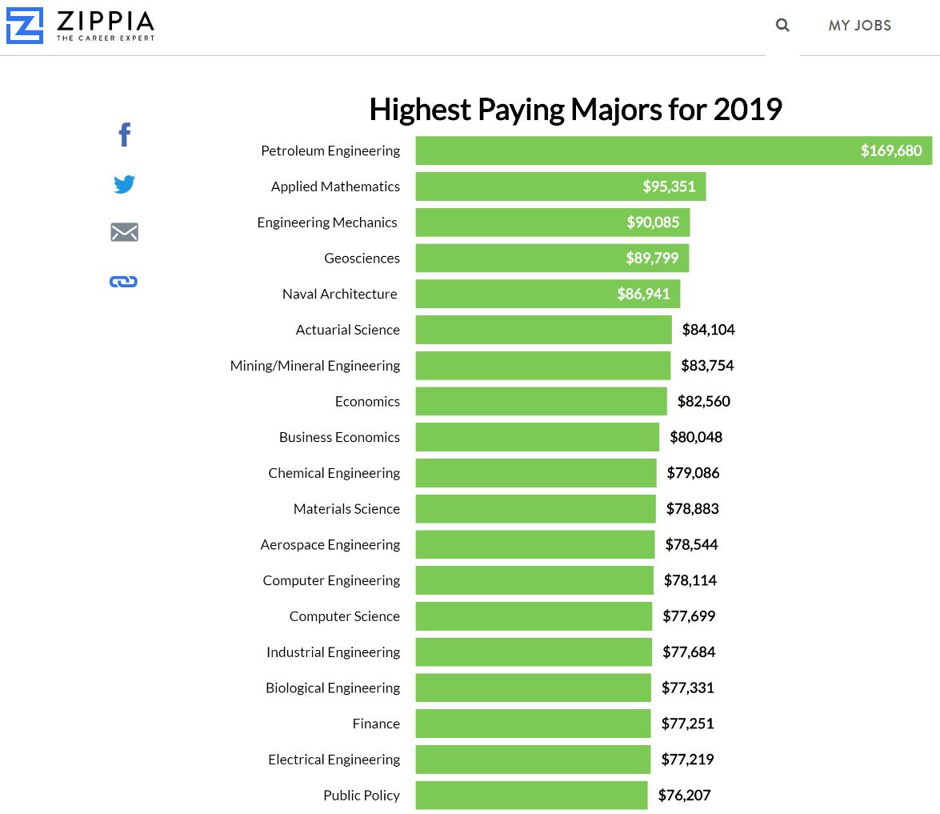
Geology is a very rewarding profession!
https://www.cnbc.com/2019/05/31/zippia-the-10-highest-paying-college-majors.html
High Salaries
The 2018 median annual salary for all geoscientists was $91,130 (Bureau of Labor Statistics). Geoscience is ranked as the fourth highest paying major by Zippia.com and Forbes magazine. Payscale.com indicates an average starting salary of $58,668 for Geologists. Starting salaries may range from $40,000 to over $100,000 depending on the position.
Excellent Job Prospects
Employment of geoscientists is projected to grow 14 percent from 2016 to 2026, faster than the average for all occupations (Bureau of Labor Statistics). The need for energy, environmental protection and responsible land and resource management (and the retirement of baby-boomers) is projected to spur demand for geoscientists in the future.

Slide 5










Private Sector
Geological/Geophysical Consulting Firms
Environmental Consulting Firms
Commercial Laboratories
Energy and Mining Companies
Conservation Organizations
Public Sector
U.S. Geological Survey
National Oceanic and Atmospheric Administration
Environmental Protection Agency
NASA
Natural Resources Conservation Service
U.S. Army Corps of Engineers
U.S. National Parks Service
U.S. Forest Service
U.S. Dept. of Agriculture
U.S. Fish and Wildlife Service
U.S. Bureau of Reclamation
National Laboratories
State Geological/Biological Surveys
County/Municipal Coastal and Environmental Management
Municipal Utilities
Careers/Employers

Slide 6
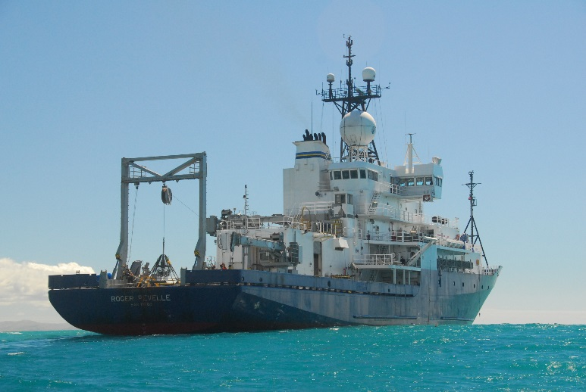
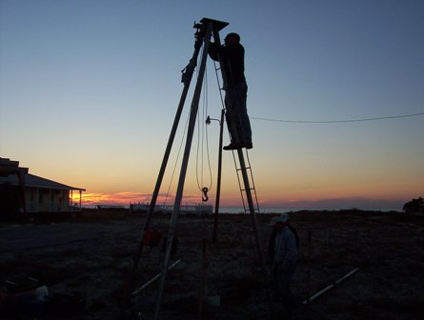
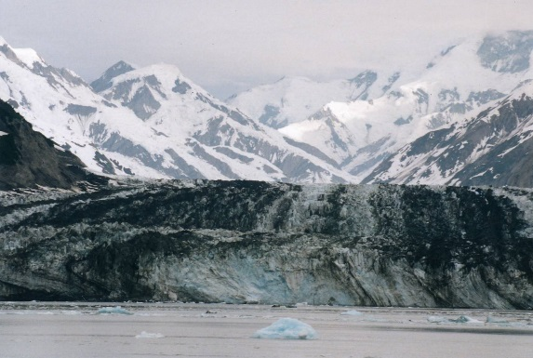
Learn and work with advanced technology
The Department of Geological Sciences at ECU has a talented faculty with excellent teaching and research experience. The Department is actively conducting research around the world in a range of environments using a diversity of state-of-the-art technology. This also provides opportunities for undergraduate research.
Great opportunities for travel and adventure
Geologists are needed to examine the mountains, rivers, oceans, and ice sheets around the planet. Of course, there is much to investigate right here in North Carolina!
Our Field Camp in Colorado and New Mexico (GEOL4000) offers a six-week capstone experience that tests your skills and prepares you for future work.

Slide 7
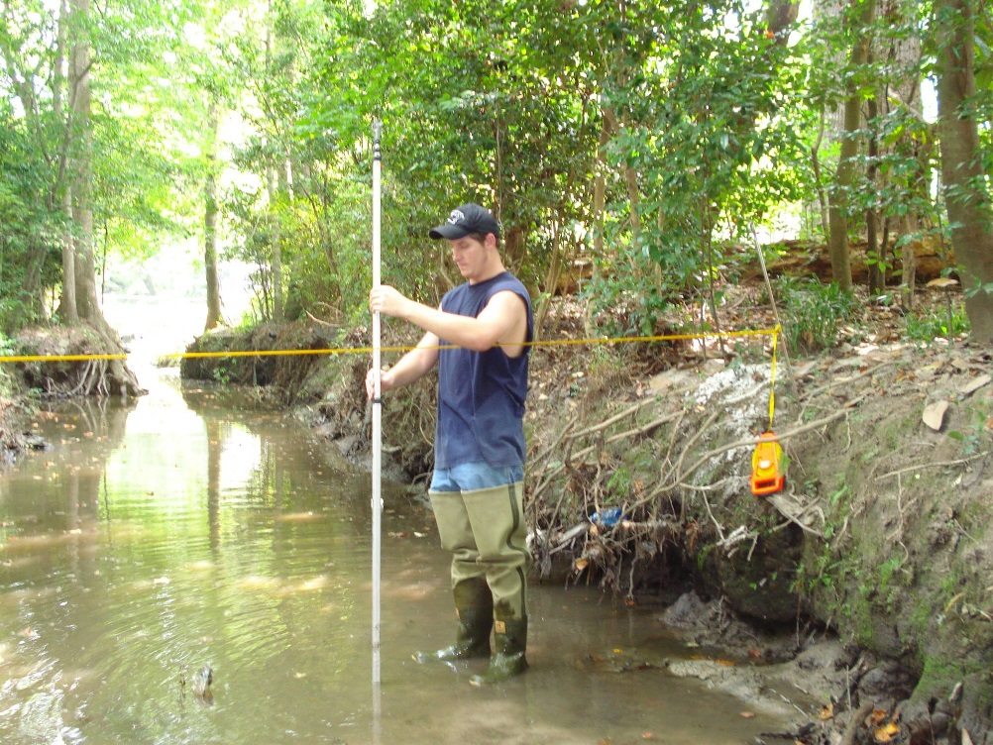
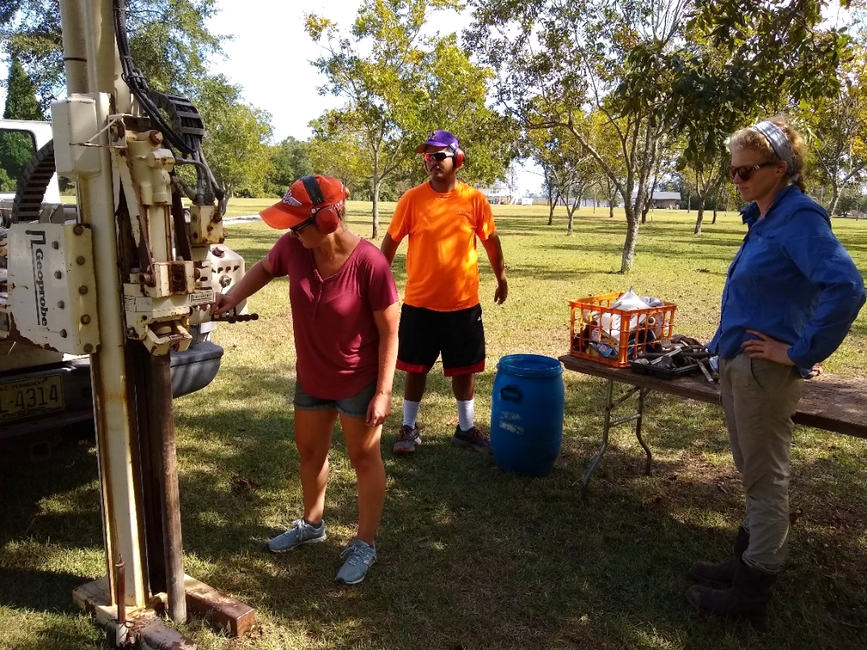
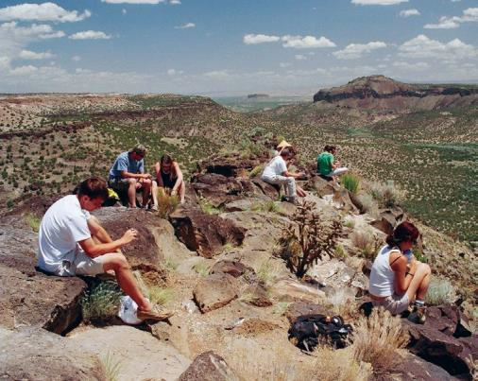
GEOLOGICAL SCIENCES
Undergraduate Degree
B.S. Geology
Concentrations in Coastal and Marine Geology, Environmental Geology, General Geology
Geology Minor
Contact:
Dr. David Mallinson
Undergraduate Program Director
mallinsond@ecu.edu

Slide 8
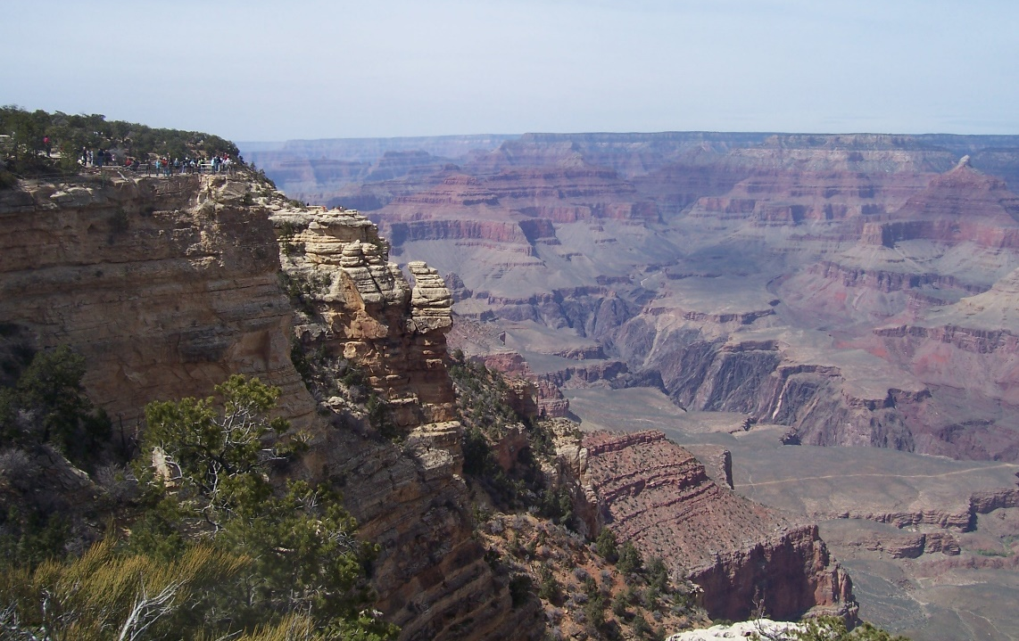
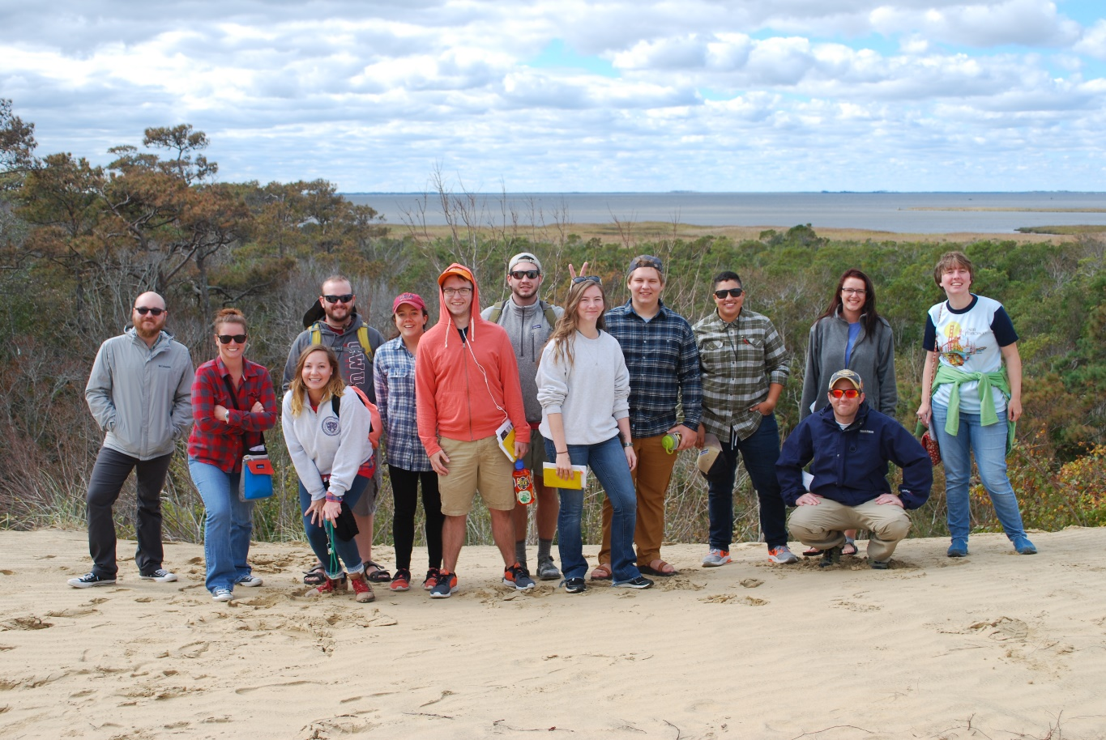
B.S. Geology
General Education (40 s.h.) – English (6 s.h.), General Chemistry I and 2 (8 s.h.), MATH 1065 College Algebra, Social Sciences (9 s.h.), Humanities and Fine Arts (9 s.h.), Health and Kinesiology (3 s.h.)
Core (42 s.h.) – Dynamic Earth, Earth and Life Through Time, Mineralogy/Petrology (1 and 2), Field Methods, Structural Geology, Sedimentology, Stratigraphy, Paleontology, Summer Field Course
Concentration (6 s.h.) – two courses under the following general categories
  Coastal and Marine Geology
  Environmental Geology
  General Geology
Cognates (15 s.h.) – Quantitative Skills, Additional Science
Electives to complete 120 s.h. requirement
Geology Minor
8 s.h. of 1500/1501 and other 1000-level Geology course
10 s.h. of Geology at or above 2000-level

Slide 9

Sample 4 Year Plan
FRESHMAN YEAR
 | Fall Semester |  |  | Spring Semester
 | GEOL 1500-1501 | 4 |  | GEOL 1600 | 4
 | ENGL 1100 | 3 |  | CHEM 1150-1151 | 4
 | MATH 1065 | 3 |  | KINE 1000 | 1
 | HLTH 1000 | 2 |  | Social Science | 3
 | Social Science | 3 |  | Humanities/Fine Arts | 3
 |  | 15 |  |  | 15
SOPHOMORE YEAR
 | Science Cognate | 4 |  | Science Cognate | 4
 | GEOL 2000 | 3 |  | GEOL Concentration | 3
 | CHEM 1160-1161 | 4 |  | PHYS 1250/1251 | 4
 | ENGL 2201 | 3 |  | Humanities/Fine Arts | 3
 |  | 14 |  |  | 14
JUNIOR YEAR
 | GEOL 3050/3051 | 4 |  | GEOL 3150/3151 | 4
 | GEOL 3200-3201 | 2 |  | GEOL 3300-3301 | 4
 | Social Science | 3 |  | Quantitative Skills Cognate | 2
 | Humanities/Fine Arts | 3 |  | Elective | 3
 | Elective | 3 |  | Elective | 3
 |  | 15 |  |  | 16
 |  | SUMMER SESSION
 | GEOL 4000 | 6
SENIOR YEAR
 | GEOL 4010-4011 | 4 |  | GEOL 4200-4201 | 4
 | GEOL Concentration | 3 |  | GEOL 4020-4021 | 3
 | Gen Ed Elective | 3 |  | Elective | 3
 | Elective | 3 |  | Elective | 2
 |  | 13 |  |  | 12
 |  |  |  | TOTAL HOURS | 120

Slide 10
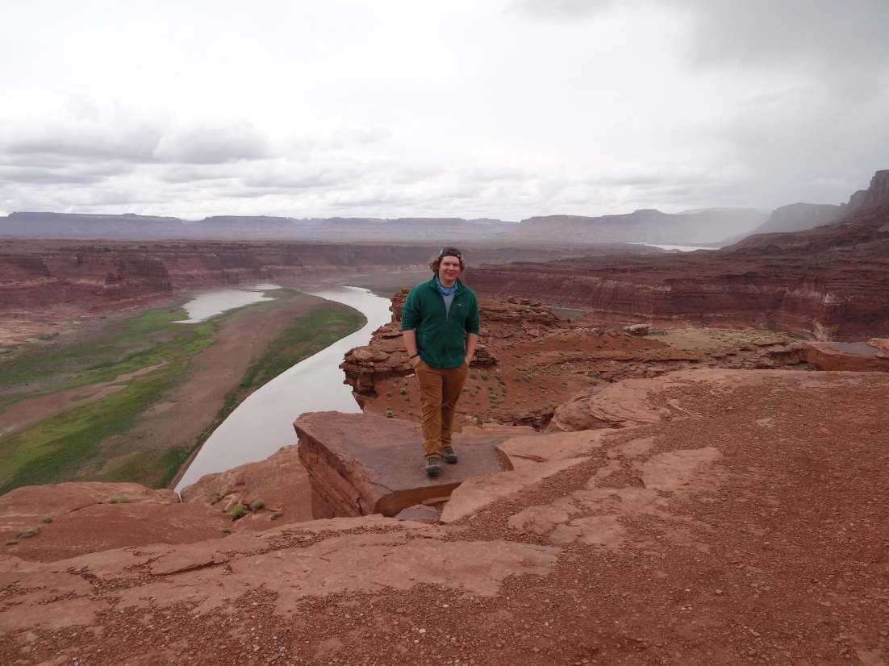
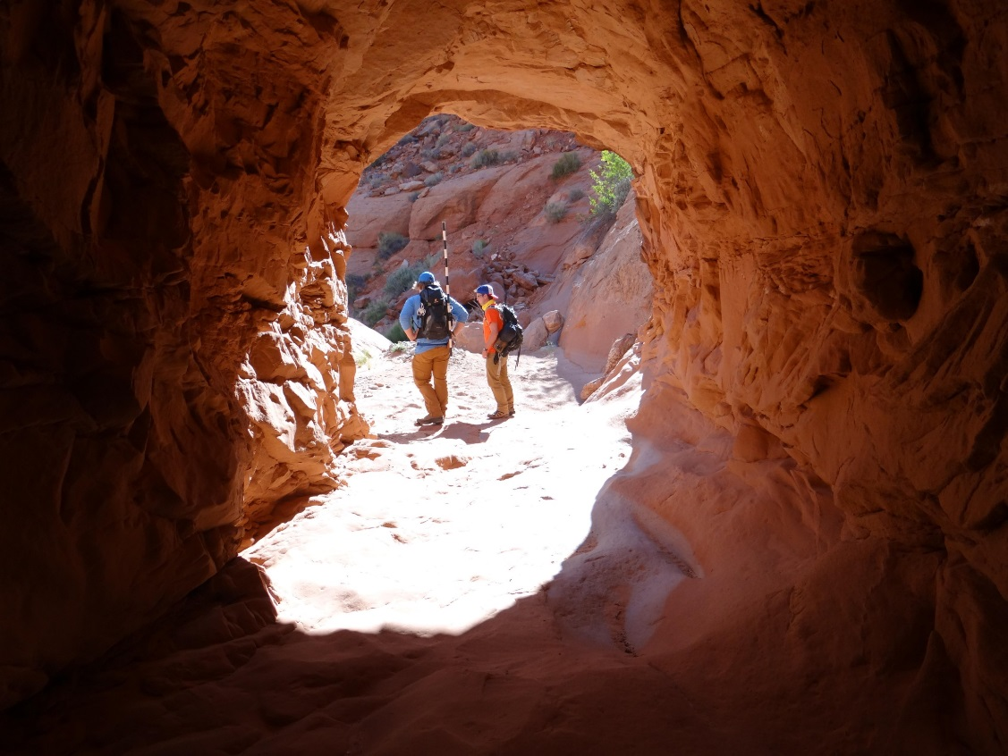
If you are interested in science, and like the idea of working outdoors either on land or on the water, you should consider geology as your major.
Check out geology web sites on the internet for more information on careers in geology.
www.geology.ecu.edu, www.agiweb.org/career, https://www.geosociety.org

